Slide 1
Allergy Prediction Using Artificial Intelligence
Client Lead: Joseph Trembley
Team Lead: Noah Ross
Minute Taker: Ella Godfrey
Research Lead: Xerxes Tarman
Quality Assurance Lead: Alex Ong
Client: Ashraf Gaffar
Advisors: Ashraf Gaffar, Ashfaq Khokhar

Slide 2
Introduction:
Goal: predict allergic reactions to medicines using machine learning
Rapid response time
Non-invasive testing
Genetic/Biological factors
Gender
Age
Skin Conditions
Skin Tone

Slide 3
Introduction: (Continued)
Implementation:
Components
React Front end
Python Back end to handle requests
Locally trained Keras model
Comparison between cloud providers
AWS
Google Cloud

Slide 4
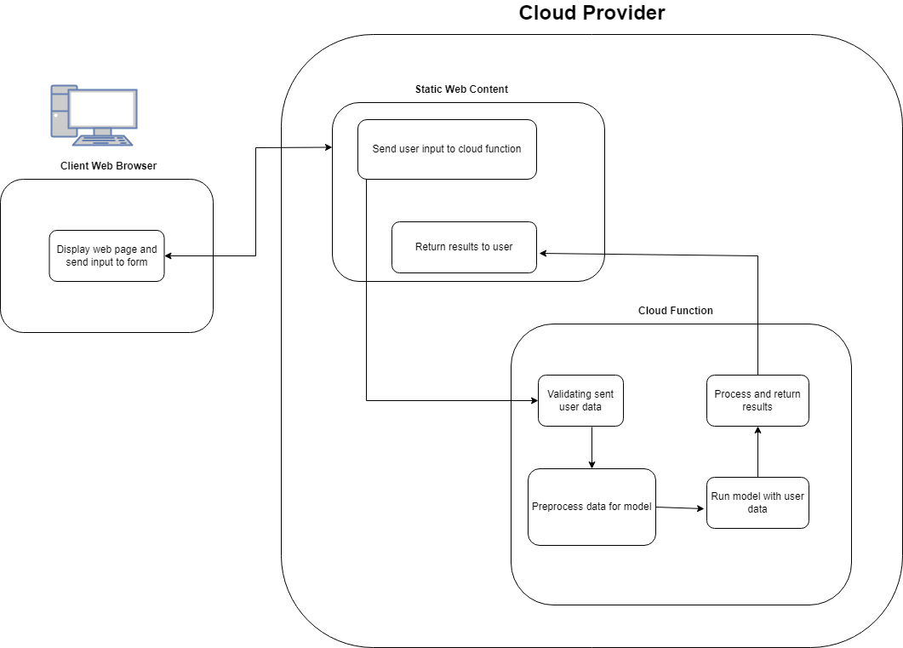
Design:
Server-Side: Data processing, validation, and running the ML model.
Client-Side: Entering user data, calling REST API, displaying prediction results.
Changes: Database and separated model have been removed from design.
Cloud providers: part of the project is comparing the ease of use, cost, and performance differences between GCP and AWS.

Slide 5
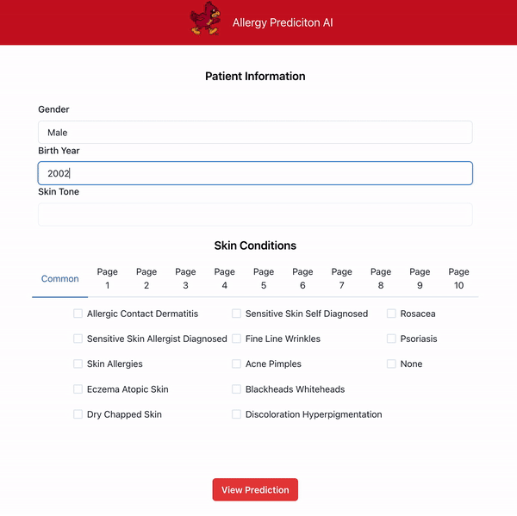
Front End
Second iteration
Sends/receives requests
Takes user data and displays information from back end
Selectable options for Skin Conditions, simplifies values to feed into the model

Slide 6
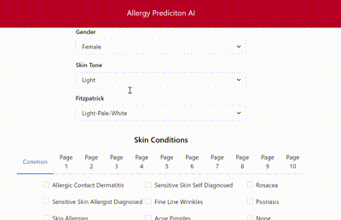
Front End (continued)
Final iteration
Constraints on user inputs
Text fields replaced with selectable dropdown boxes. Preventing random inputs
Fully connected to the serverless functions and AI model.
Predictions showcase potential allergens in the format of ingredient ids
Dataset limitation: only ingredient ids provided, no labels or names

Slide 7
Cloud Function
Python code to get model response
Receives request from front end
Prepares request for model
Runs model using request input
Returns response to user

Slide 8
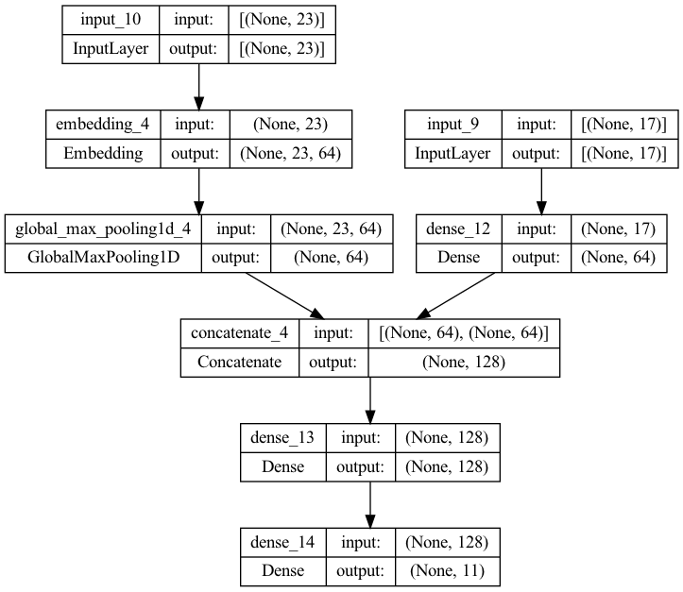
Model
Originally a separate component
Integrated as part of the cloud function
Rigorous testing and evaluations
Precision - 0.35
Recall - 0.86
F1-Score - 0.65
Compared to SVM and Random Forest

Slide 9
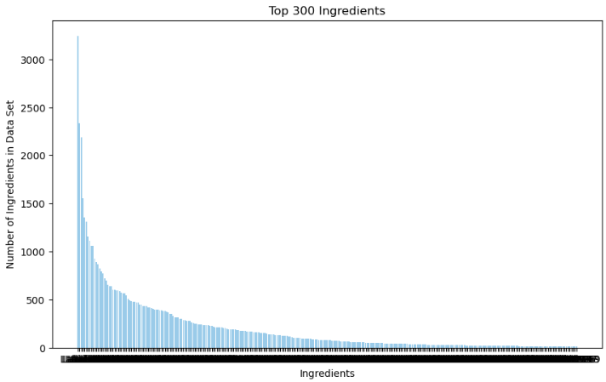
Different Model Tested Overview
Random Forest
Class | Precision | Recall | F1-Score | Support
0 | 0.36 | 0.52 | 0.42 | 664
1 | 0.28 | 0.58 | 0.38 | 456
2 | 0.25 | 0.56 | 0.34 | 426
3 | 0.19 | 0.54 | 0.29 | 328
4 | 0.14 | 0.53 | 0.23 | 249
5 | 0.14 | 0.47 | 0.22 | 276
6 | 0.11 | 0.44 | 0.18 | 225
7 | 0.15 | 0.56 | 0.23 | 235
8 | 0.12 | 0.54 | 0.20 | 218
Micro Avg | 0.20 | 0.53 | 0.29 | 3077
Macro Avg | 0.19 | 0.53 | 0.28 | 3077
Weighted Avg | 0.23 | 0.53 | 0.31 | 3077
Samples Avg | 0.19 | 0.40 | 0.23 | 3077

Slide 10
GCP vs AWS:
Compared Metrics: Cost to run, time to compute, and ease of use
GCP was slightly more intuitive, and more visible

Slide 11
Challenges/Solutions:
Producing a model with high recall and precision is difficult
Explore various algorithms to identify the most suitable approach
Enhance the parameters to optimize performance metrics
Data difficult to understand
Knowing actual allergies nearly impossible
Communicate numbers represent ingredient ids

Slide 12
Conclusion:
Neural Networks are time-consuming to develop
Machine Learning requires great quality and quantity of data
The cloud is a great hosting platform for web apps
GCP is preferable for our use case

